Slide 1
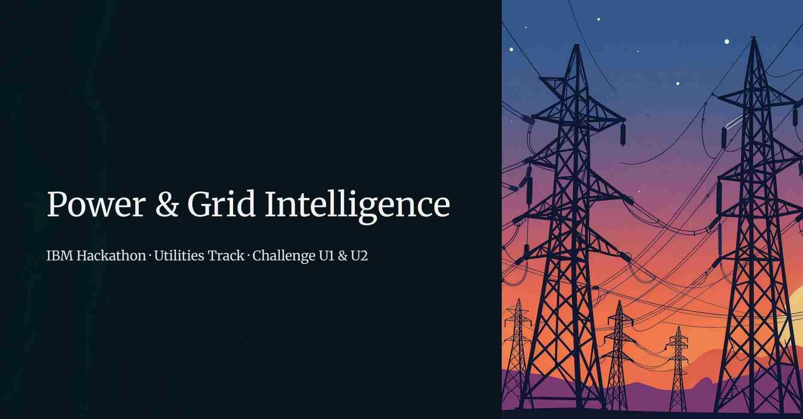

Slide 2
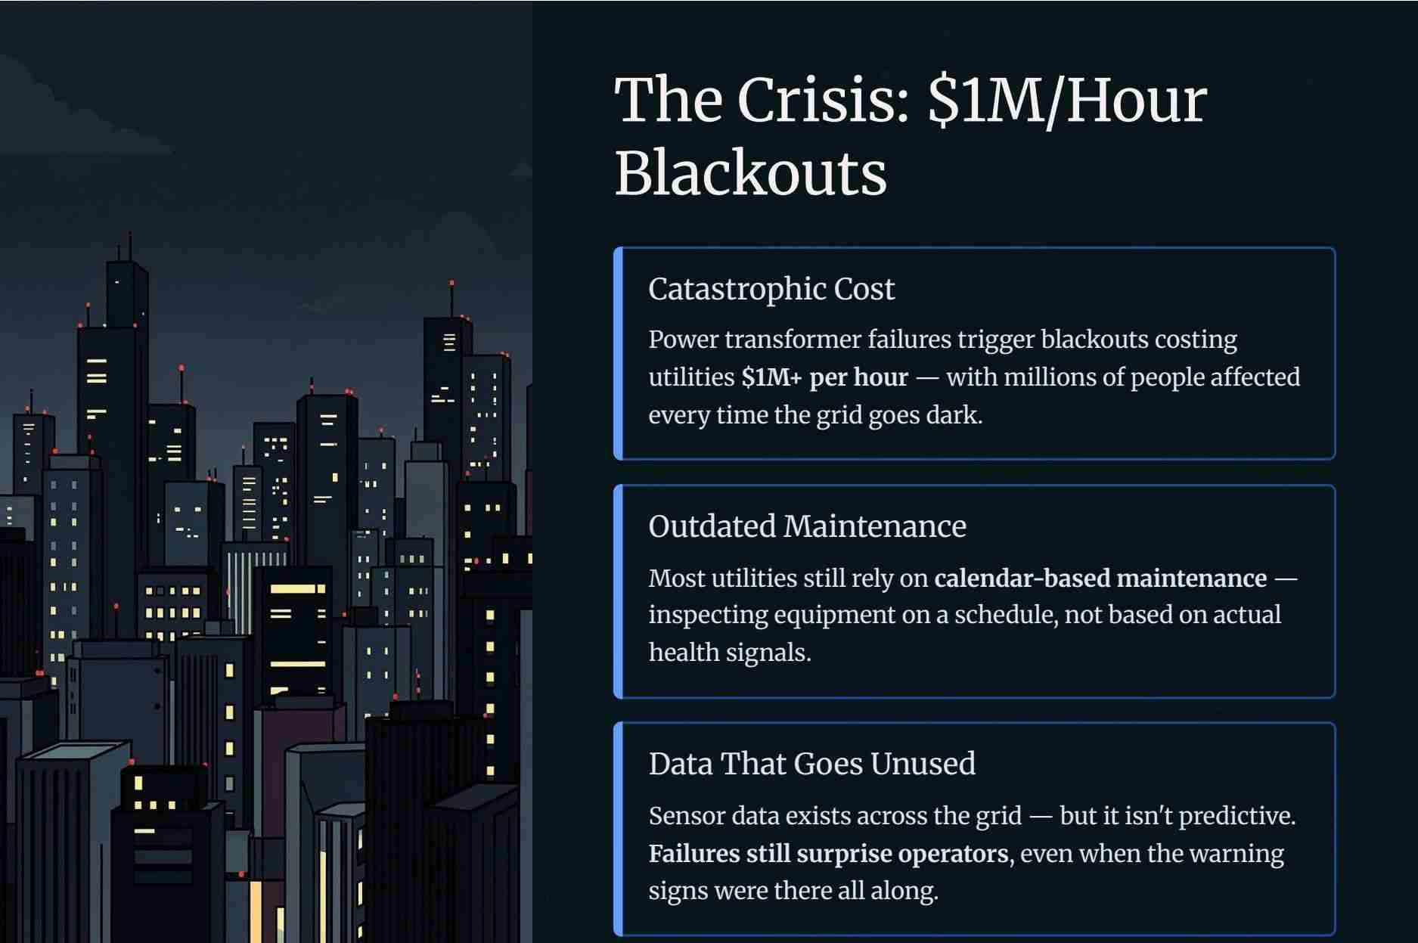

Slide 3
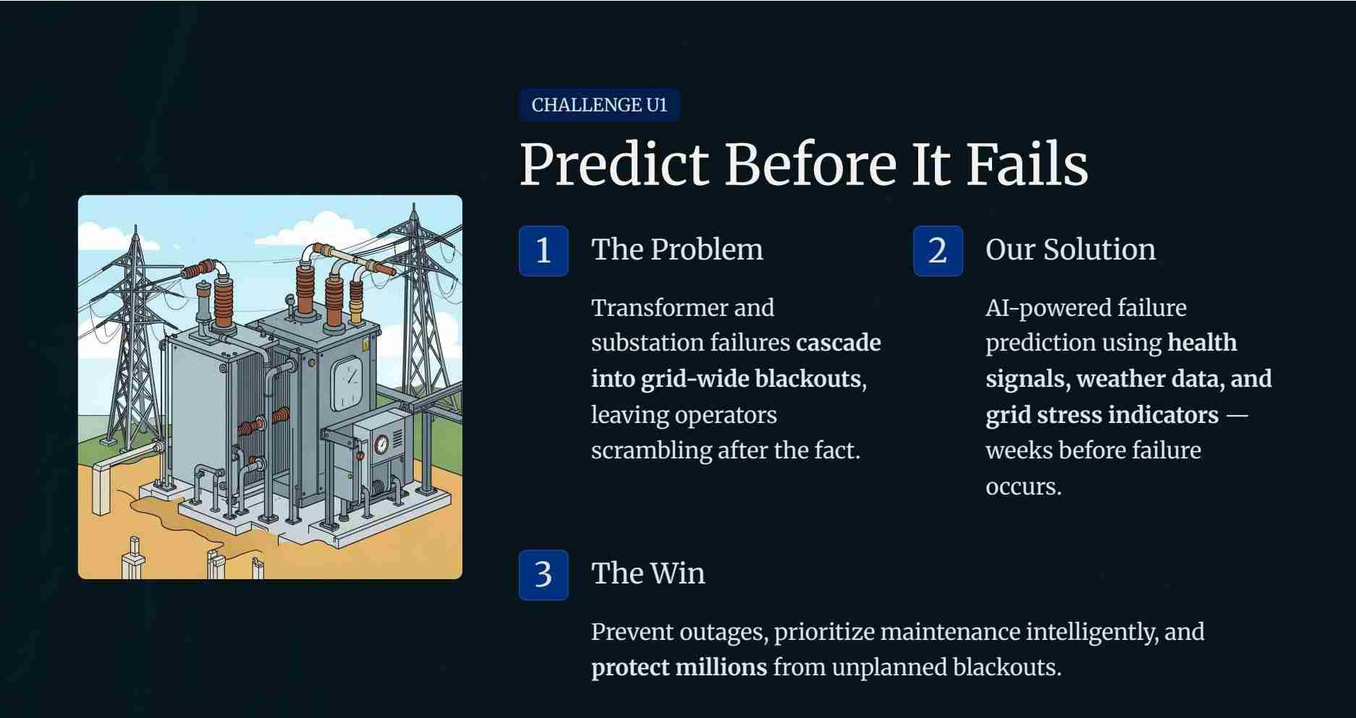

Slide 4
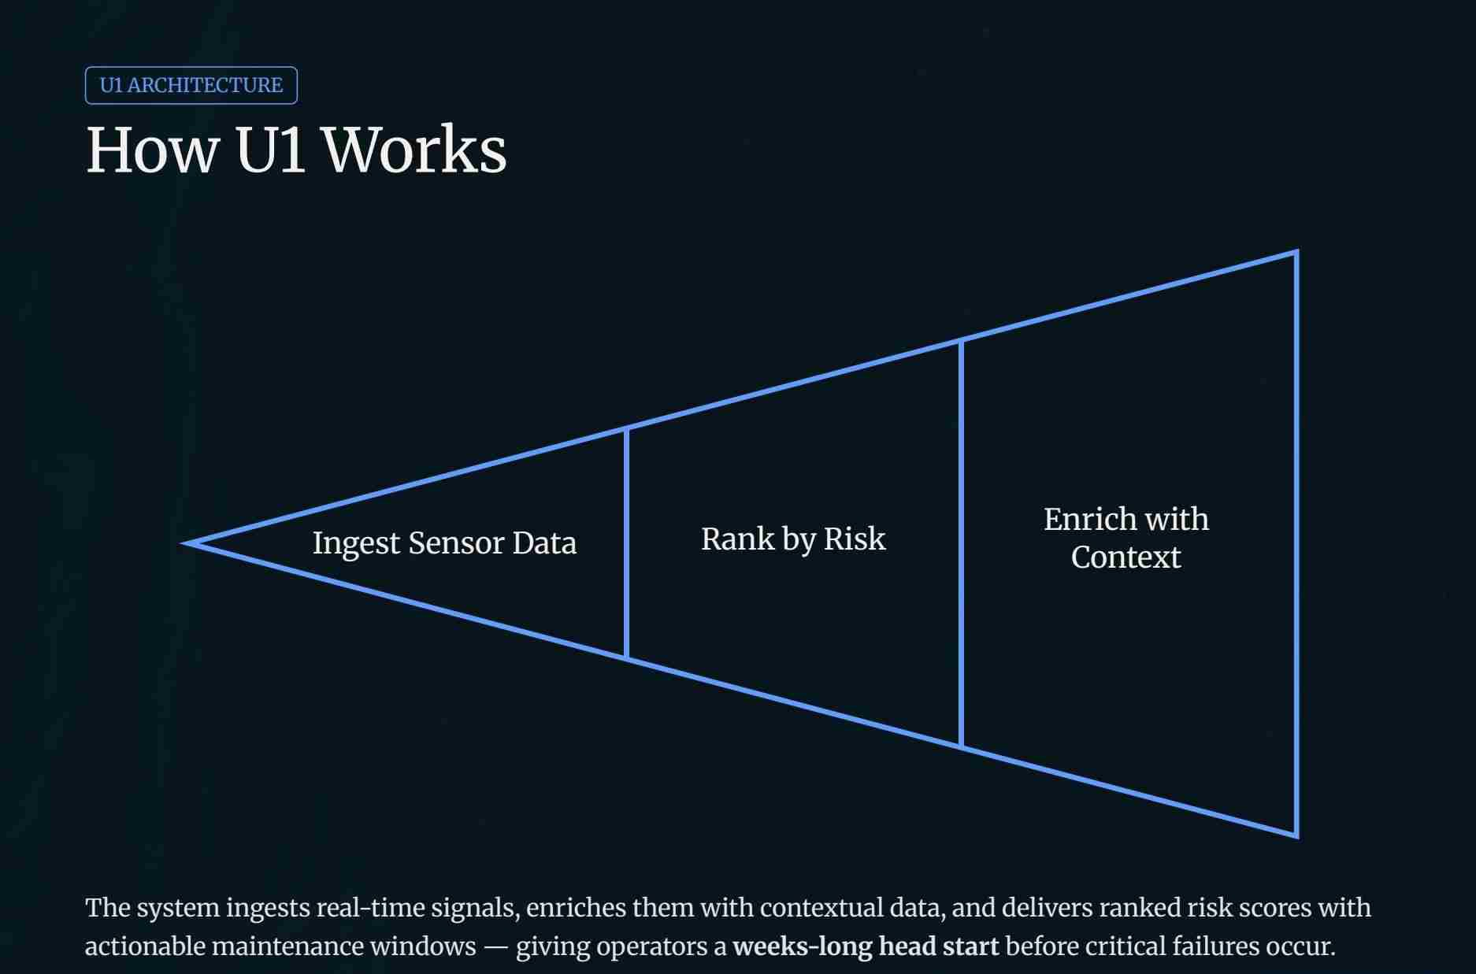

Slide 5
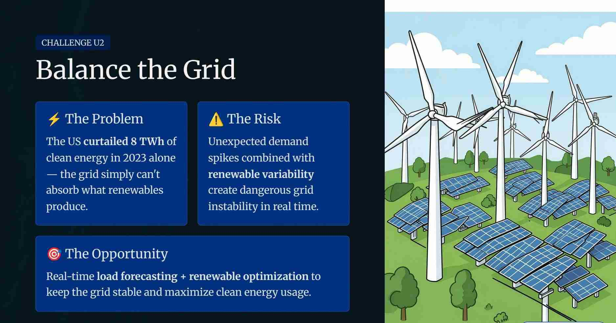

Slide 6
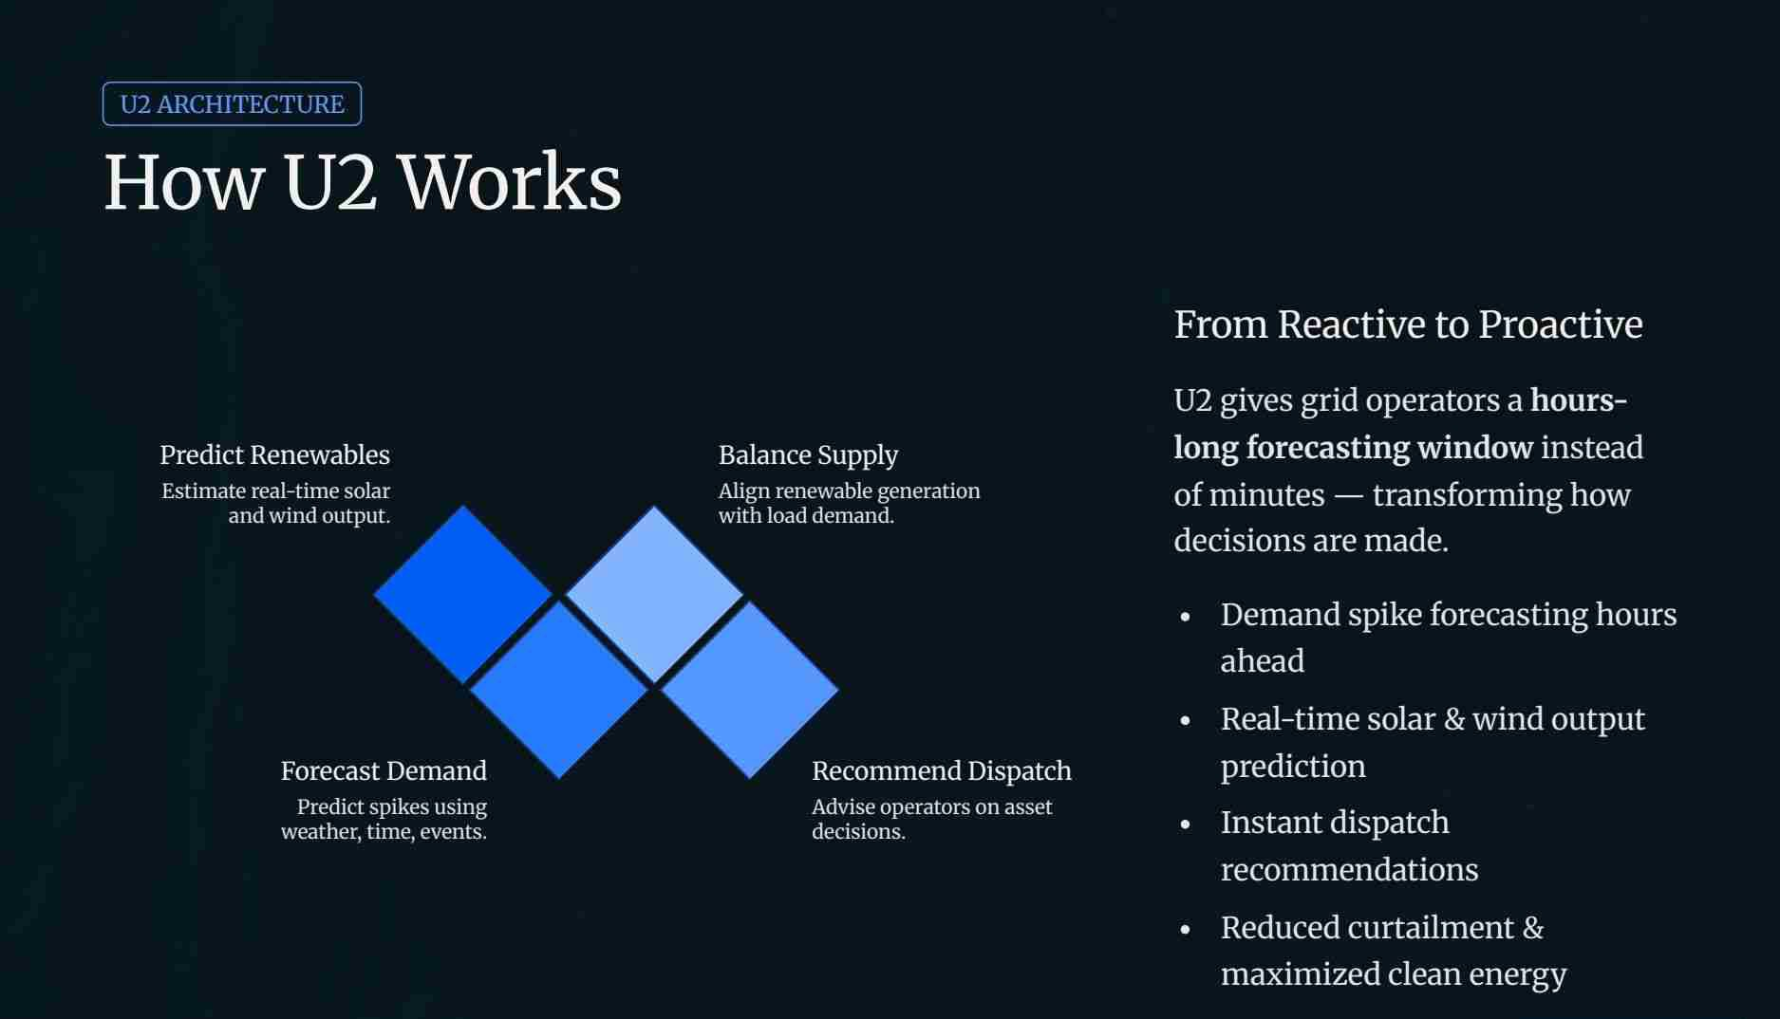

Slide 7
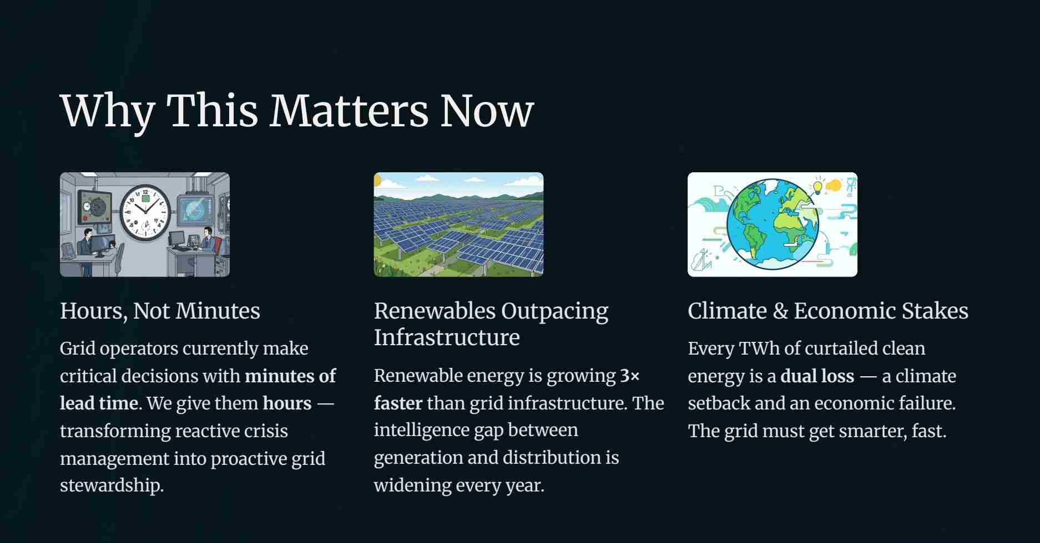

Slide 8
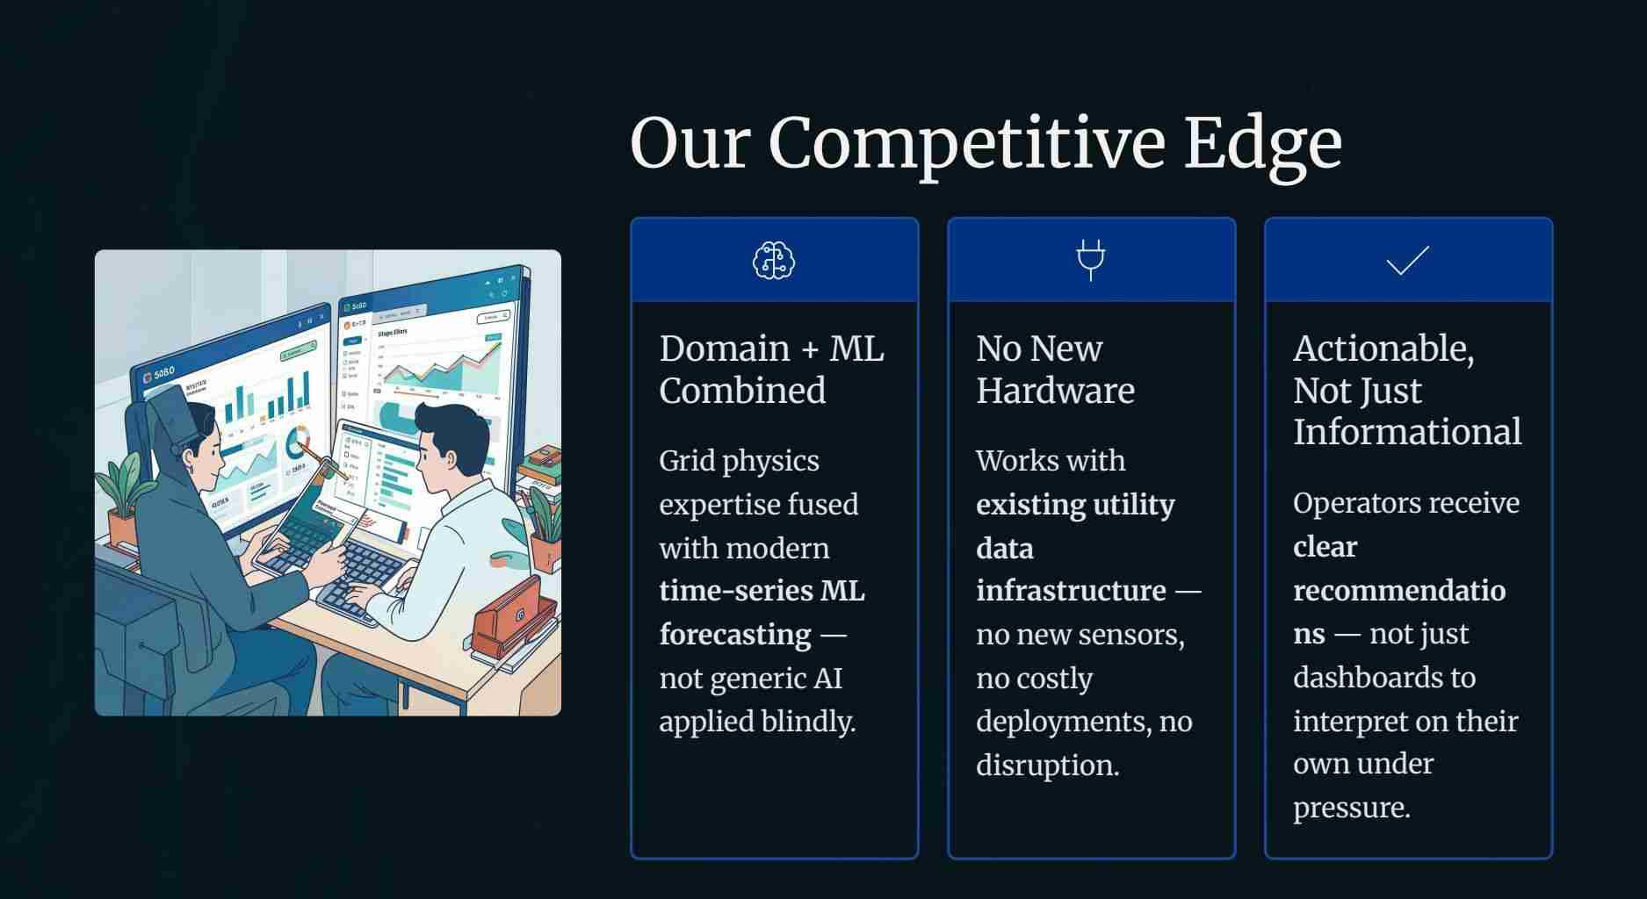

Slide 9
Impact
& Scale
1000+
$500M
Outages Prevented
Annual Savings
Per utility, per year - through Ul predictive
In avoided blackout costs and emergency response
maintenance
across a single utility
2-3TWh
40°/o+
Clean Energy Unlocked
Curtailment Reduction
Renewable capacity recovered through 02 curtailment
Less wasted renewable energy, more stable and
reduction
efficient grid operations
[J
Combined Ul
+
U2: A resilient, clean, and intelligent grid - built on IBM's Utilities Track platform.

Slide 10
